Slide 1

Project Title –Seasonal Agriculture Performance Analysis
Student Name- Prerna Bharat Pande
College Name-Bajaj Institute of Technology
AICTE STU ID : STU6887b31e883141753723678

Slide 2

PROBLEM STATEMENT
Agricultural activities are influenced by seasonal variations in environmental conditions, farming practices, resource availability and market conditions. As a result, agricultural performance may differ from one season to another. However, raw agricultural data does not clearly explain how agricultural performance changes across seasons or what patterns can be observed in different seasonal conditions. The problem is to analyze the given agricultural dataset and investigate seasonal differences in agricultural performance by identifying meaningful patterns, trends, relationships and variations within the available data.

Slide 3
Project Description
This project analyzes 4,000 farm records spanning three agricultural seasons — Kharif, Rabi and Zaid — across 8 Indian states and 8 major crops. The dataset captures environmental conditions (rainfall, temperature, soil health), farming inputs (fertilizer, irrigation, pesticide), and economic outcomes (yield, cost, revenue, profit). Using Python (Pandas, Seaborn) in Google Colab, the data was cleaned, explored and statistically tested to uncover how season affects agricultural performance — and whether the differences observed are meaningful or just random variation.

Slide 4

WHO ARE THE END USERS?
Farmers planning which season/crop combination is most profitable
Agricultural policy makers and government agencies (subsidy & planning decisions)
Agri-fintech and insurance companies (seasonal risk assessment)
Agricultural research institutions and NGOs
Irrigation and resource-management planners

Slide 5

Technology Used
Python 3, Google Colab
Pandas, NumPy — data handling & cleaning
Matplotlib, Seaborn — visualization and charts
GitHub — version control & submission

Slide 6
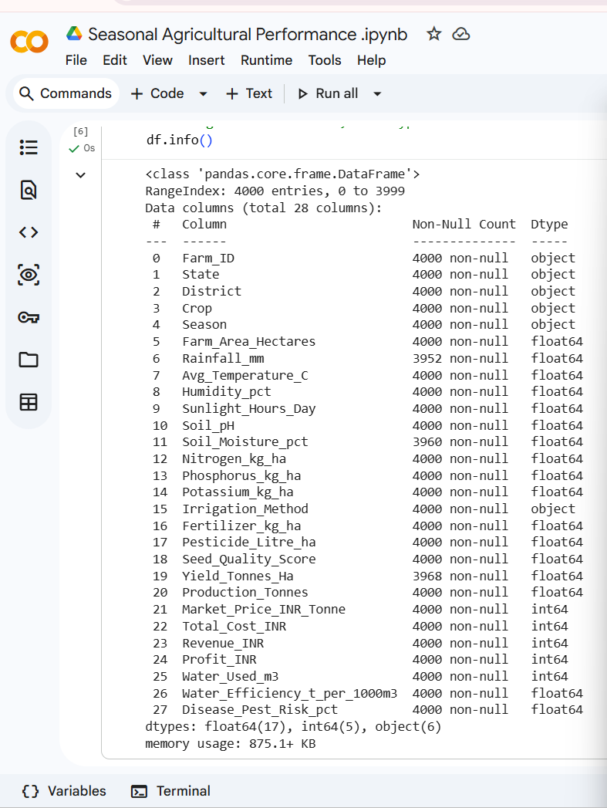
RESULTS
1) Data Understanding: output — shows all 28 columns, their data types, and non-null counts.
"Dataset has 4,000 rows and 28 columns; a few columns had missing data before cleaning."

Slide 7
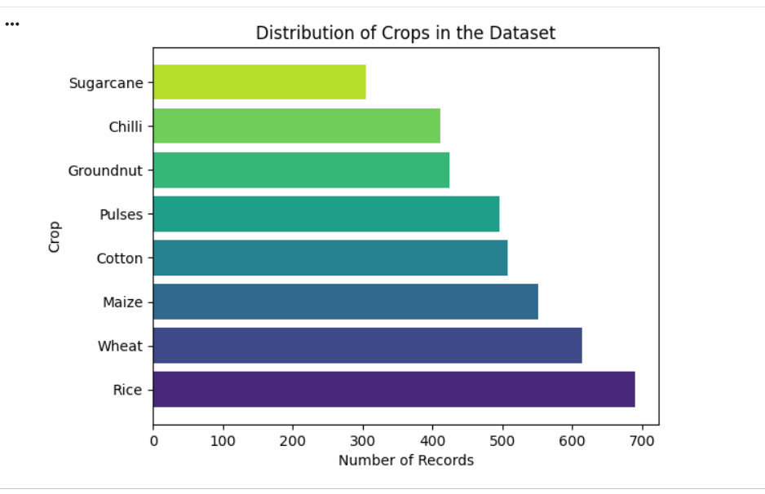
RESULTS
2) “Distribution of crops” bar chart shows which crops appear most often in the dataset with Rice, Wheat and Cotton being the most common ones grown.

Slide 8
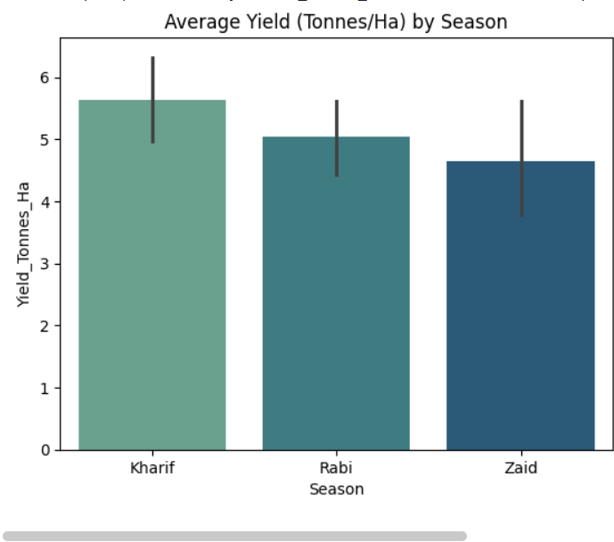
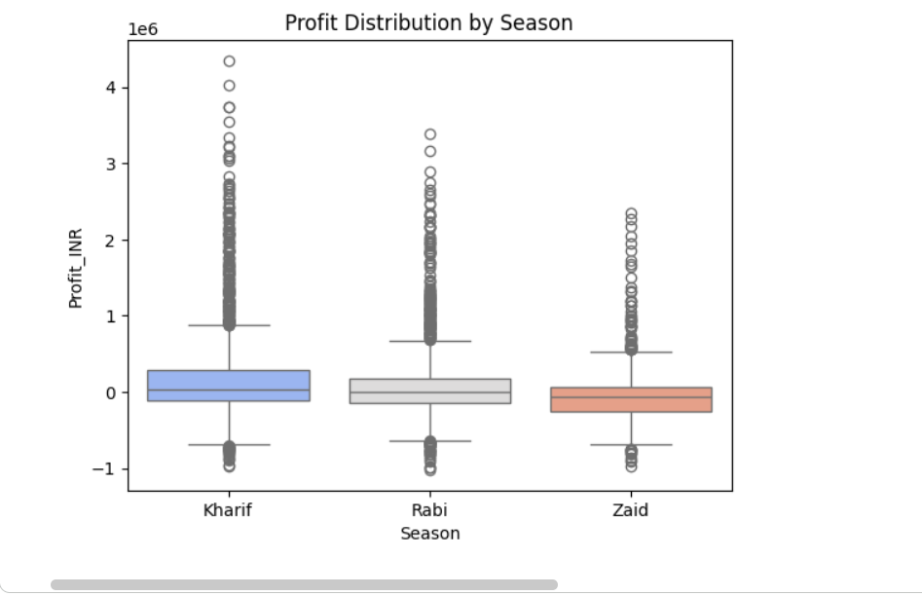
RESULTS –Season wise yield and Profit
3) “Average Yield by Season” bar chart
shows which season produces more crop yield where Kharif has the highest average yield, followed by Rabi, then Zaid.
4)"Profit Distribution by Season" boxplot
shows which season makes more profit, and how consistent that profit is.

Slide 9
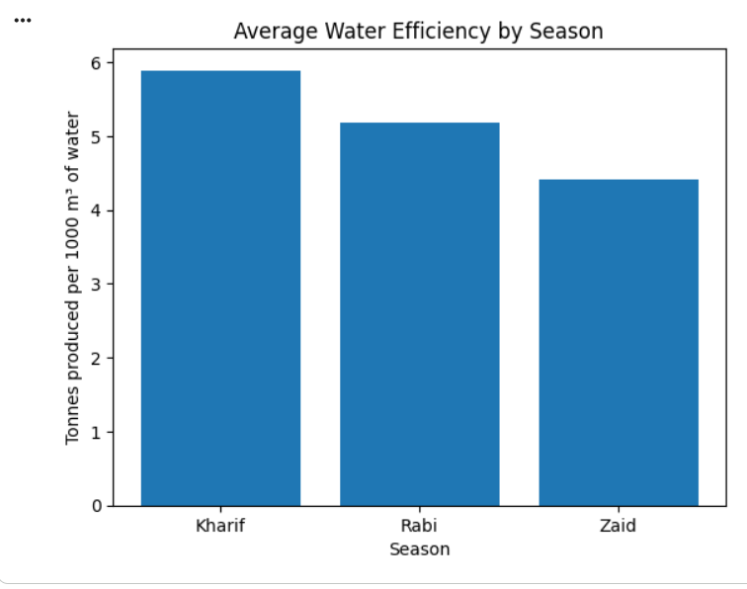
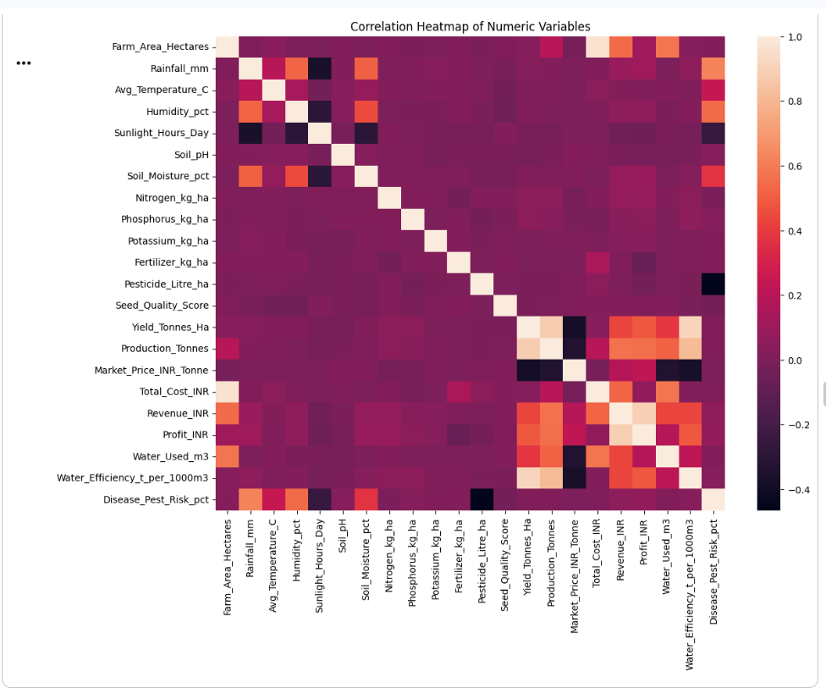
RESULTS -Water Usage & Correlation
5)."Average Water Efficiency by Season" bar chart
shows which season uses water most efficiently where Kharif is most efficient while Zaid is the least efficient.
6)”Correlation heatmap”
shows what factors actually affect yield and profit the most i.e.Water efficiency and production volume

Slide 10
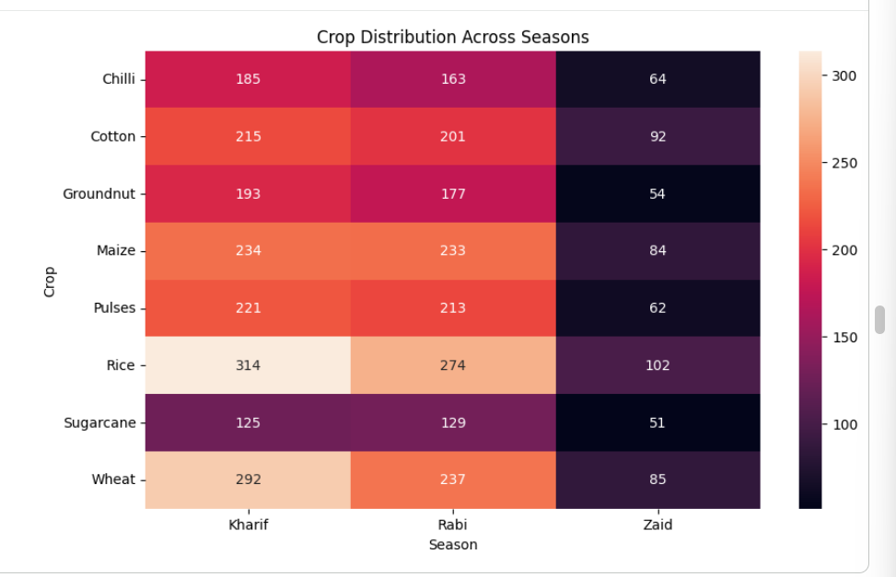
RESULTS-Crop Patterns & Irrigation
7)“Crop-Season heatmap”(crosstab of Crop vs Season)shows which crops are grown mostly in which season but Most crops are grown heavily in one particular season rather than spread evenly across all three.

Slide 11
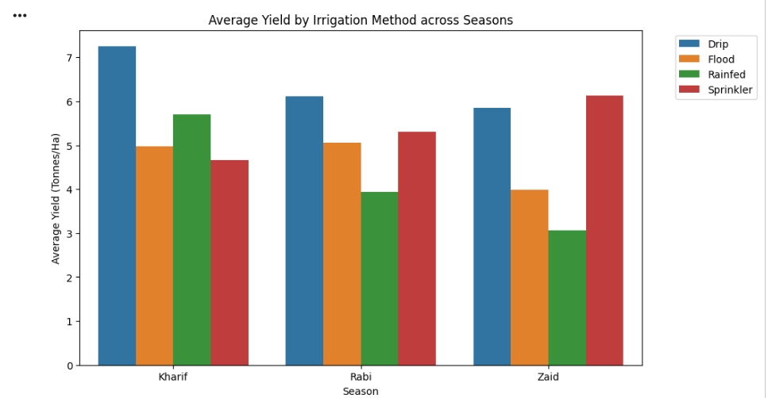
RESULTS
8)"Yield by Irrigation Method, Season wise" bar chart
shows which irrigation method gives better yield i.e. Drip irrigation

Slide 12
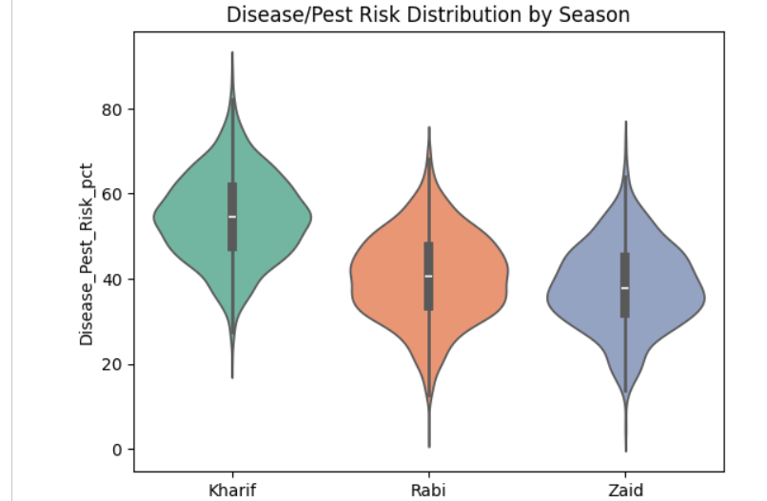
RESULTS -Deeper Findings as per me
9)”Disease/Pest Risk by Season” violin plot
shows which season has higher risk of crop disease/pests

Slide 13
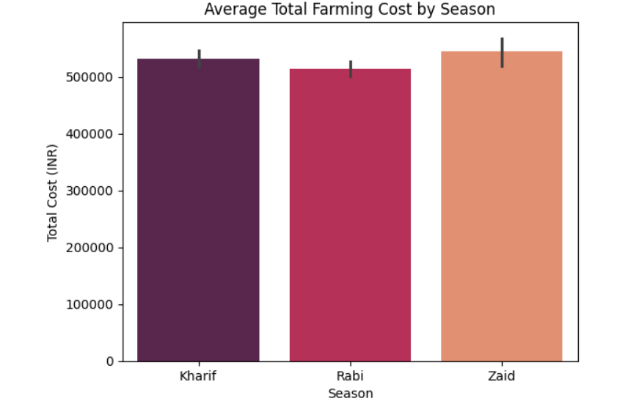
RESULTS
10)"Average Total Cost by Season" bar chart (from your Student Analysis 3)
shows which season costs the most to farm in, and why Zaid ends up in loss
Zaid has the highest farming cost of the three seasons — this, not a lower market price, is why it's the least profitable.

Slide 14
Future scope
Extend analysis with machine learning (yield/profit prediction models)
Incorporate real-time weather API data for live seasonal forecasting
Build an interactive dashboard (Power BI) for farmers
Expand dataset across more states/years for deeper regional trend analysis

Slide 15
GitHub Link

Slide 16
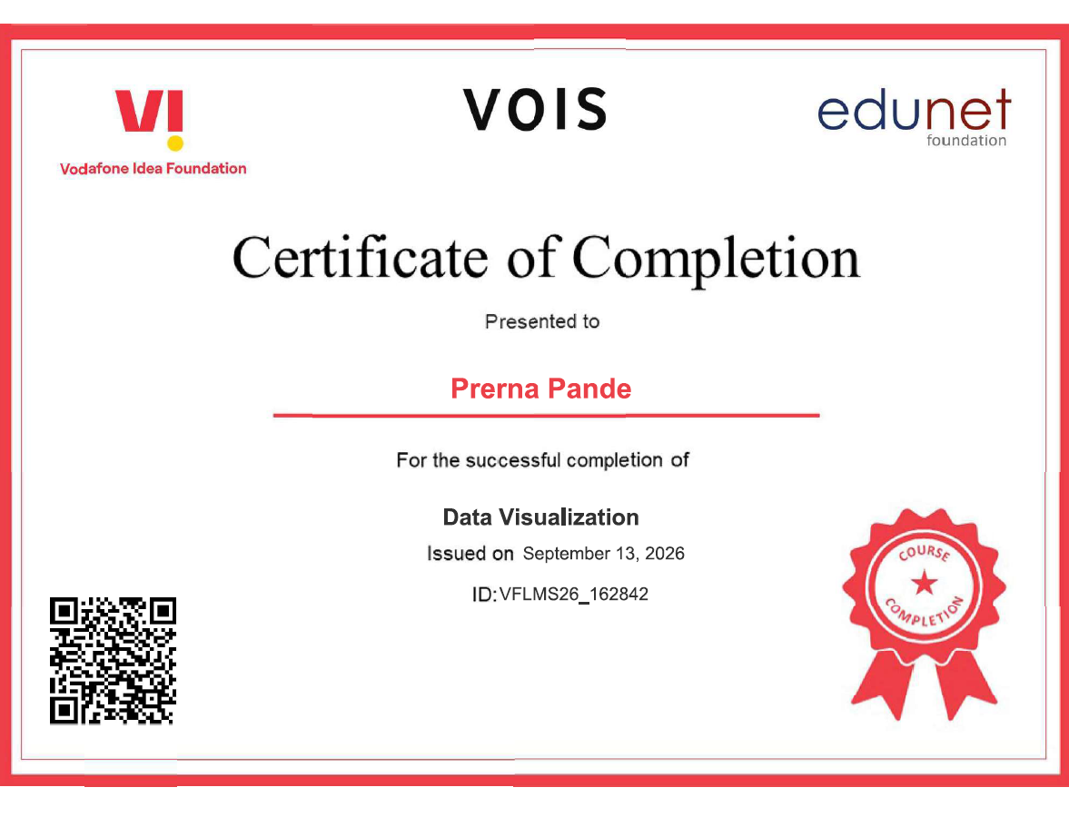
VOIS Course completion certificate -
Course name- Data Visualization

Slide 17
Thank you
.
.

